Slide 1


Slide 2


Slide 3
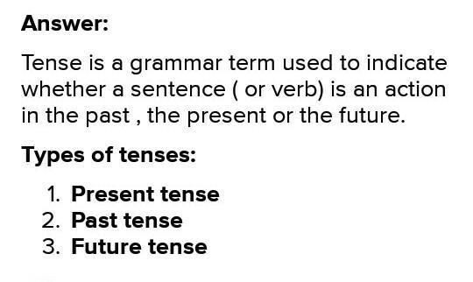

Slide 4
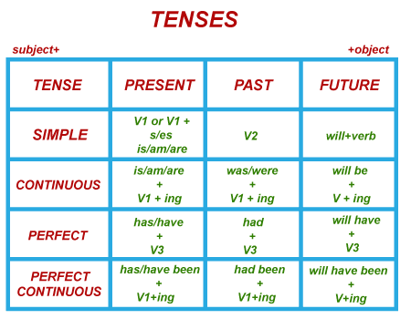

Slide 5
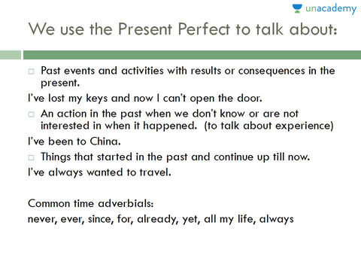
PRESENT PERFECT

Slide 6
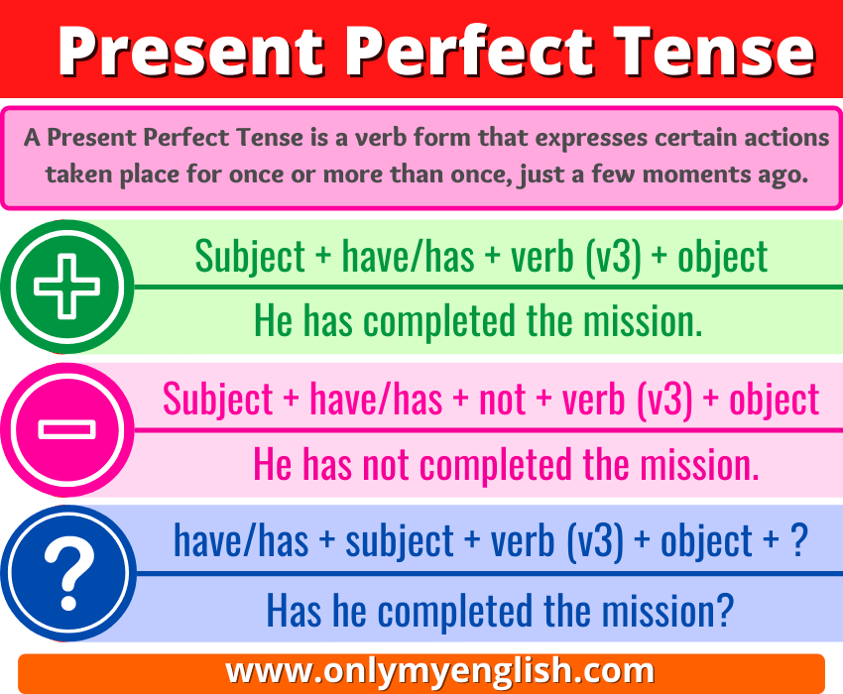

Slide 7
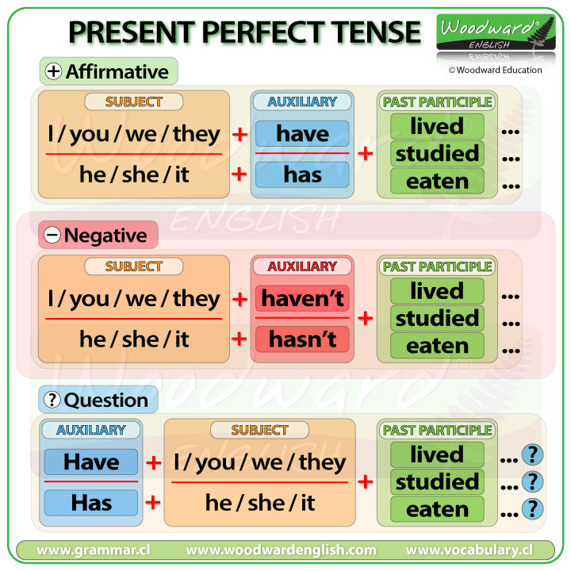
PRESENT PERFECT

Slide 8
The Present Perfect
The present perfect is used to talk about an event that began in the past and continues up to the present.
He has lived in Modesto for two years.
(He began living in Modesto two years ago and he still lives there.)

Slide 9
The Present Perfect
The present perfect is also used to talk about an event that was completed in the past, but the specific time of the event is not important.
I have seen that movie before.
He has already visited Vietnam.
(Specific dates and times are not mentioned.)

Slide 10
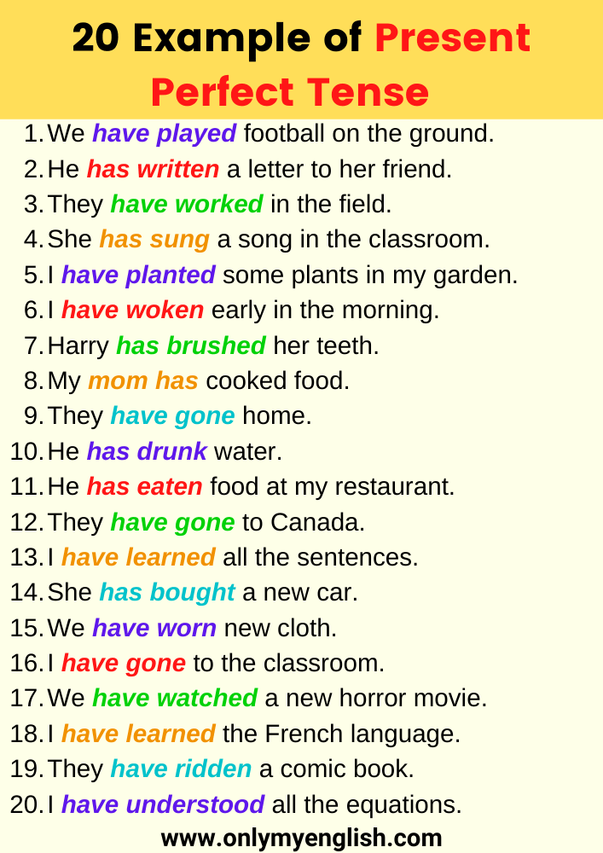

Slide 11
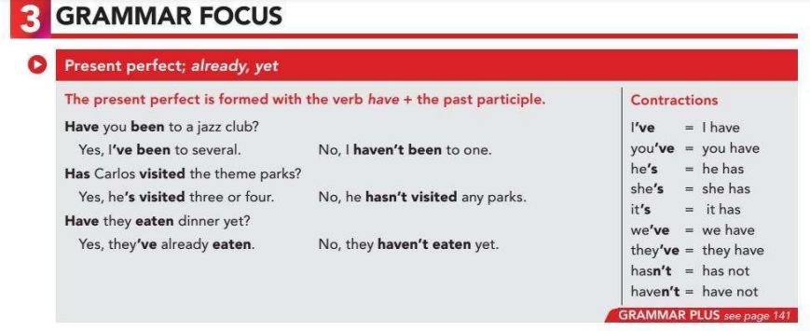

Slide 12
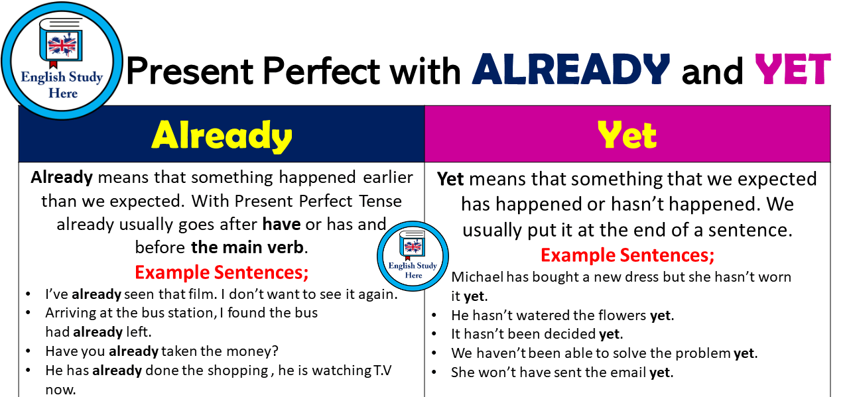

Slide 13
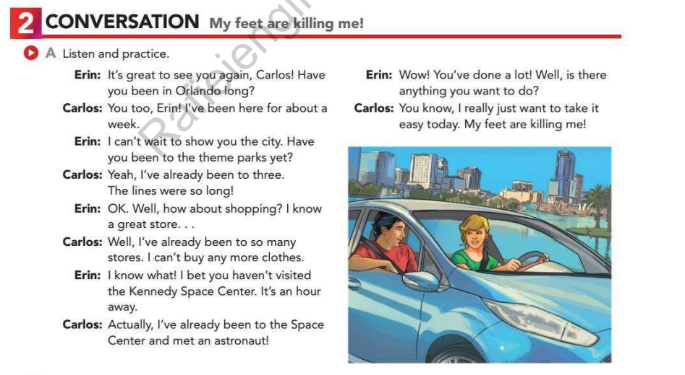

Slide 14
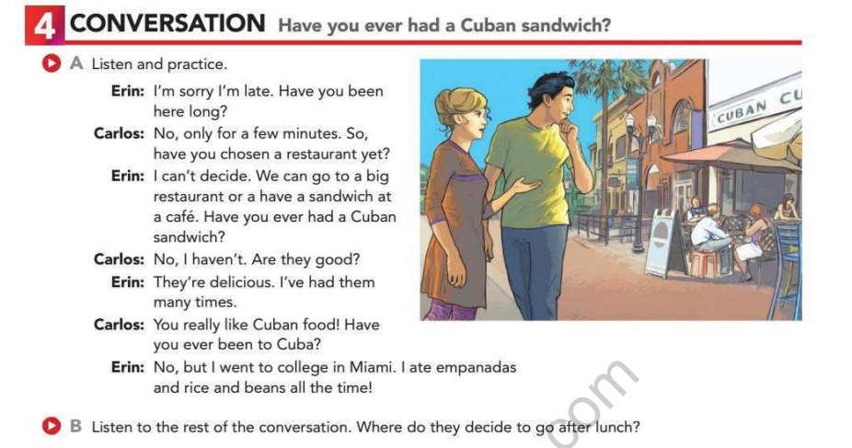

Slide 15
REGULAR AND IRREGULAR PAST PARTICIPLES
If you can form the simple past tense and past participle of a verb simply by adding “–ed” or “–d” to it, then it’s a regular verb. A verb that doesn’t follow these patterns is an irregular verb.

Slide 16
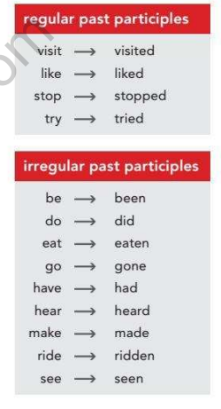

Slide 17
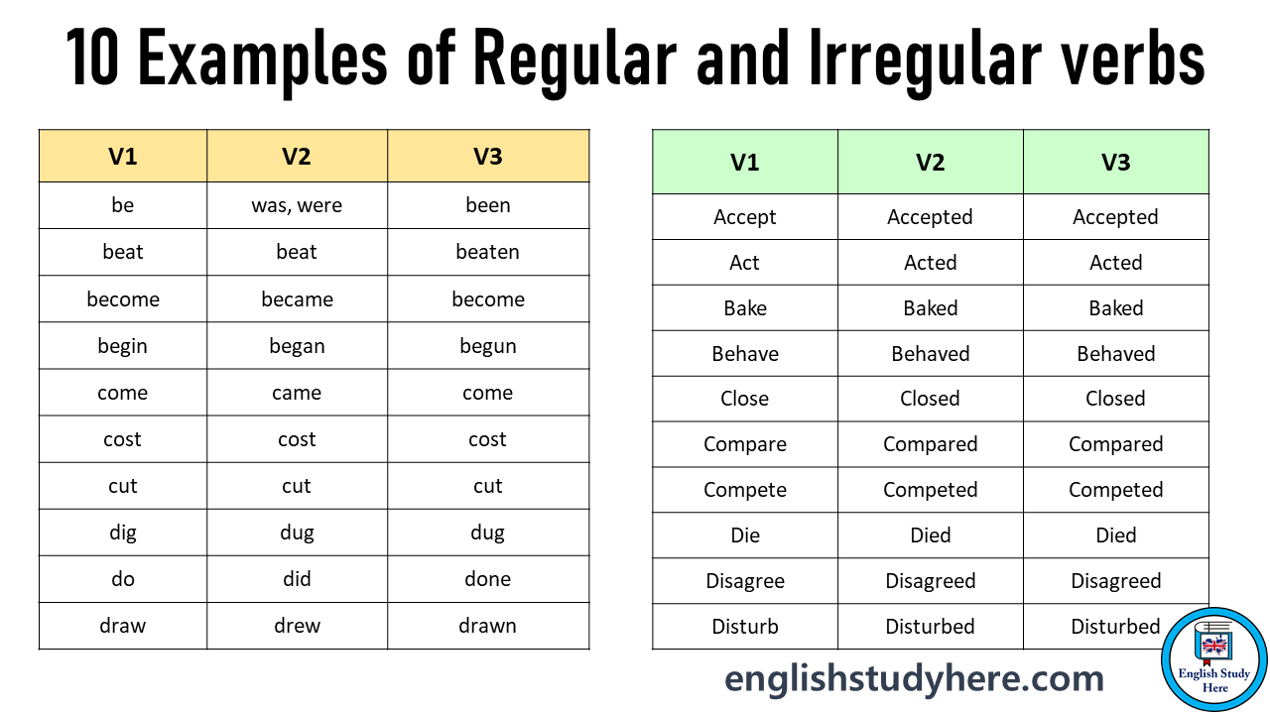

Slide 18
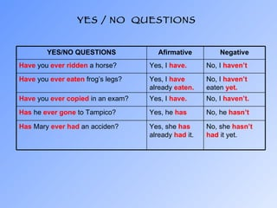
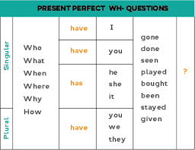
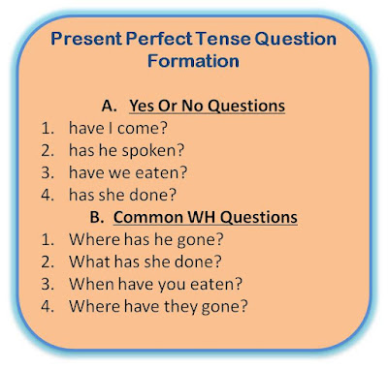

Slide 19
SIMPLE PAST
The simple past tense, in English, is used to represent an action/event that took place in the past. With many verbs, the simple past tense is formed by adding an 'ed' or a 'd' to the end of the base verb.

Slide 20
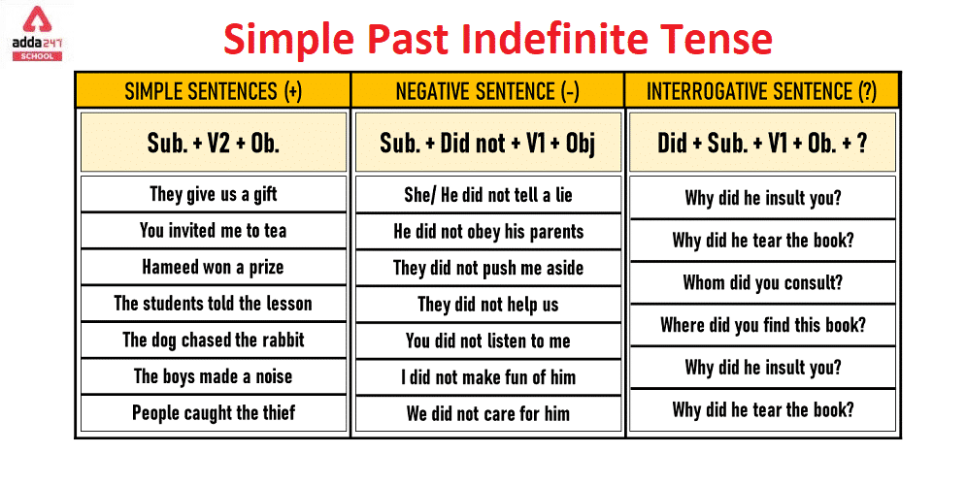

Slide 21
The Simple Past
We use the simple past to indicate exactly when an action or event took place in the past.
I visited my sister yesterday.
We went out to dinner last night.

Slide 22
The Simple Past
The simple past is used to describe actions and/or events that are now completed and no longer true in the present.
I attended MJC in 1998. (I no longer attend MJC.)
I saw a movie every weekend when I was a teenager. (I don’t see movies very much anymore.)

Slide 23
The Simple Past is used for actions that started and finished at a specific time in the past. It’s also possible to use the simple past in a sentence without specifying a time, but it must have previously been made clear that the speaker is referring to a finished period.
I saw a movie last week.

Slide 24
The Simple Past is used to describe several actions that were completed in the past or a series of actions.
I finished work, walked to the beach and met my friends.

Slide 25
The Simple Past is used to describe a process that started and finished in the past. In this case, the process of the action is long and is used by specifying time periods such as ‘the whole year’ or ‘all day’.
I lived in Italy for five years.

Slide 26
The Simple Past can also be used in sentences that describe past habits. These sentences have the same purpose as the expression ‘used to’. It should be clear in this kind of sentence that the action referred to is a habit. Time expressions like always, often, usually and never can be used to underline this.
I often played football when I was a young man

Slide 27
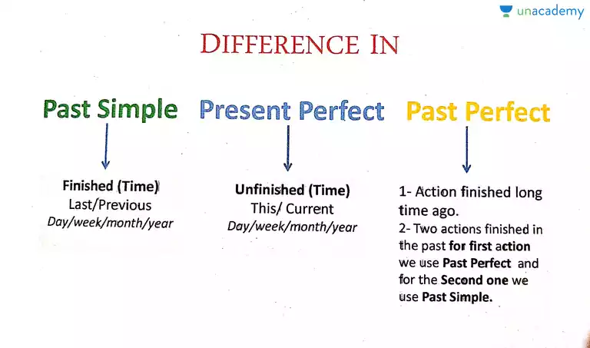

Slide 28
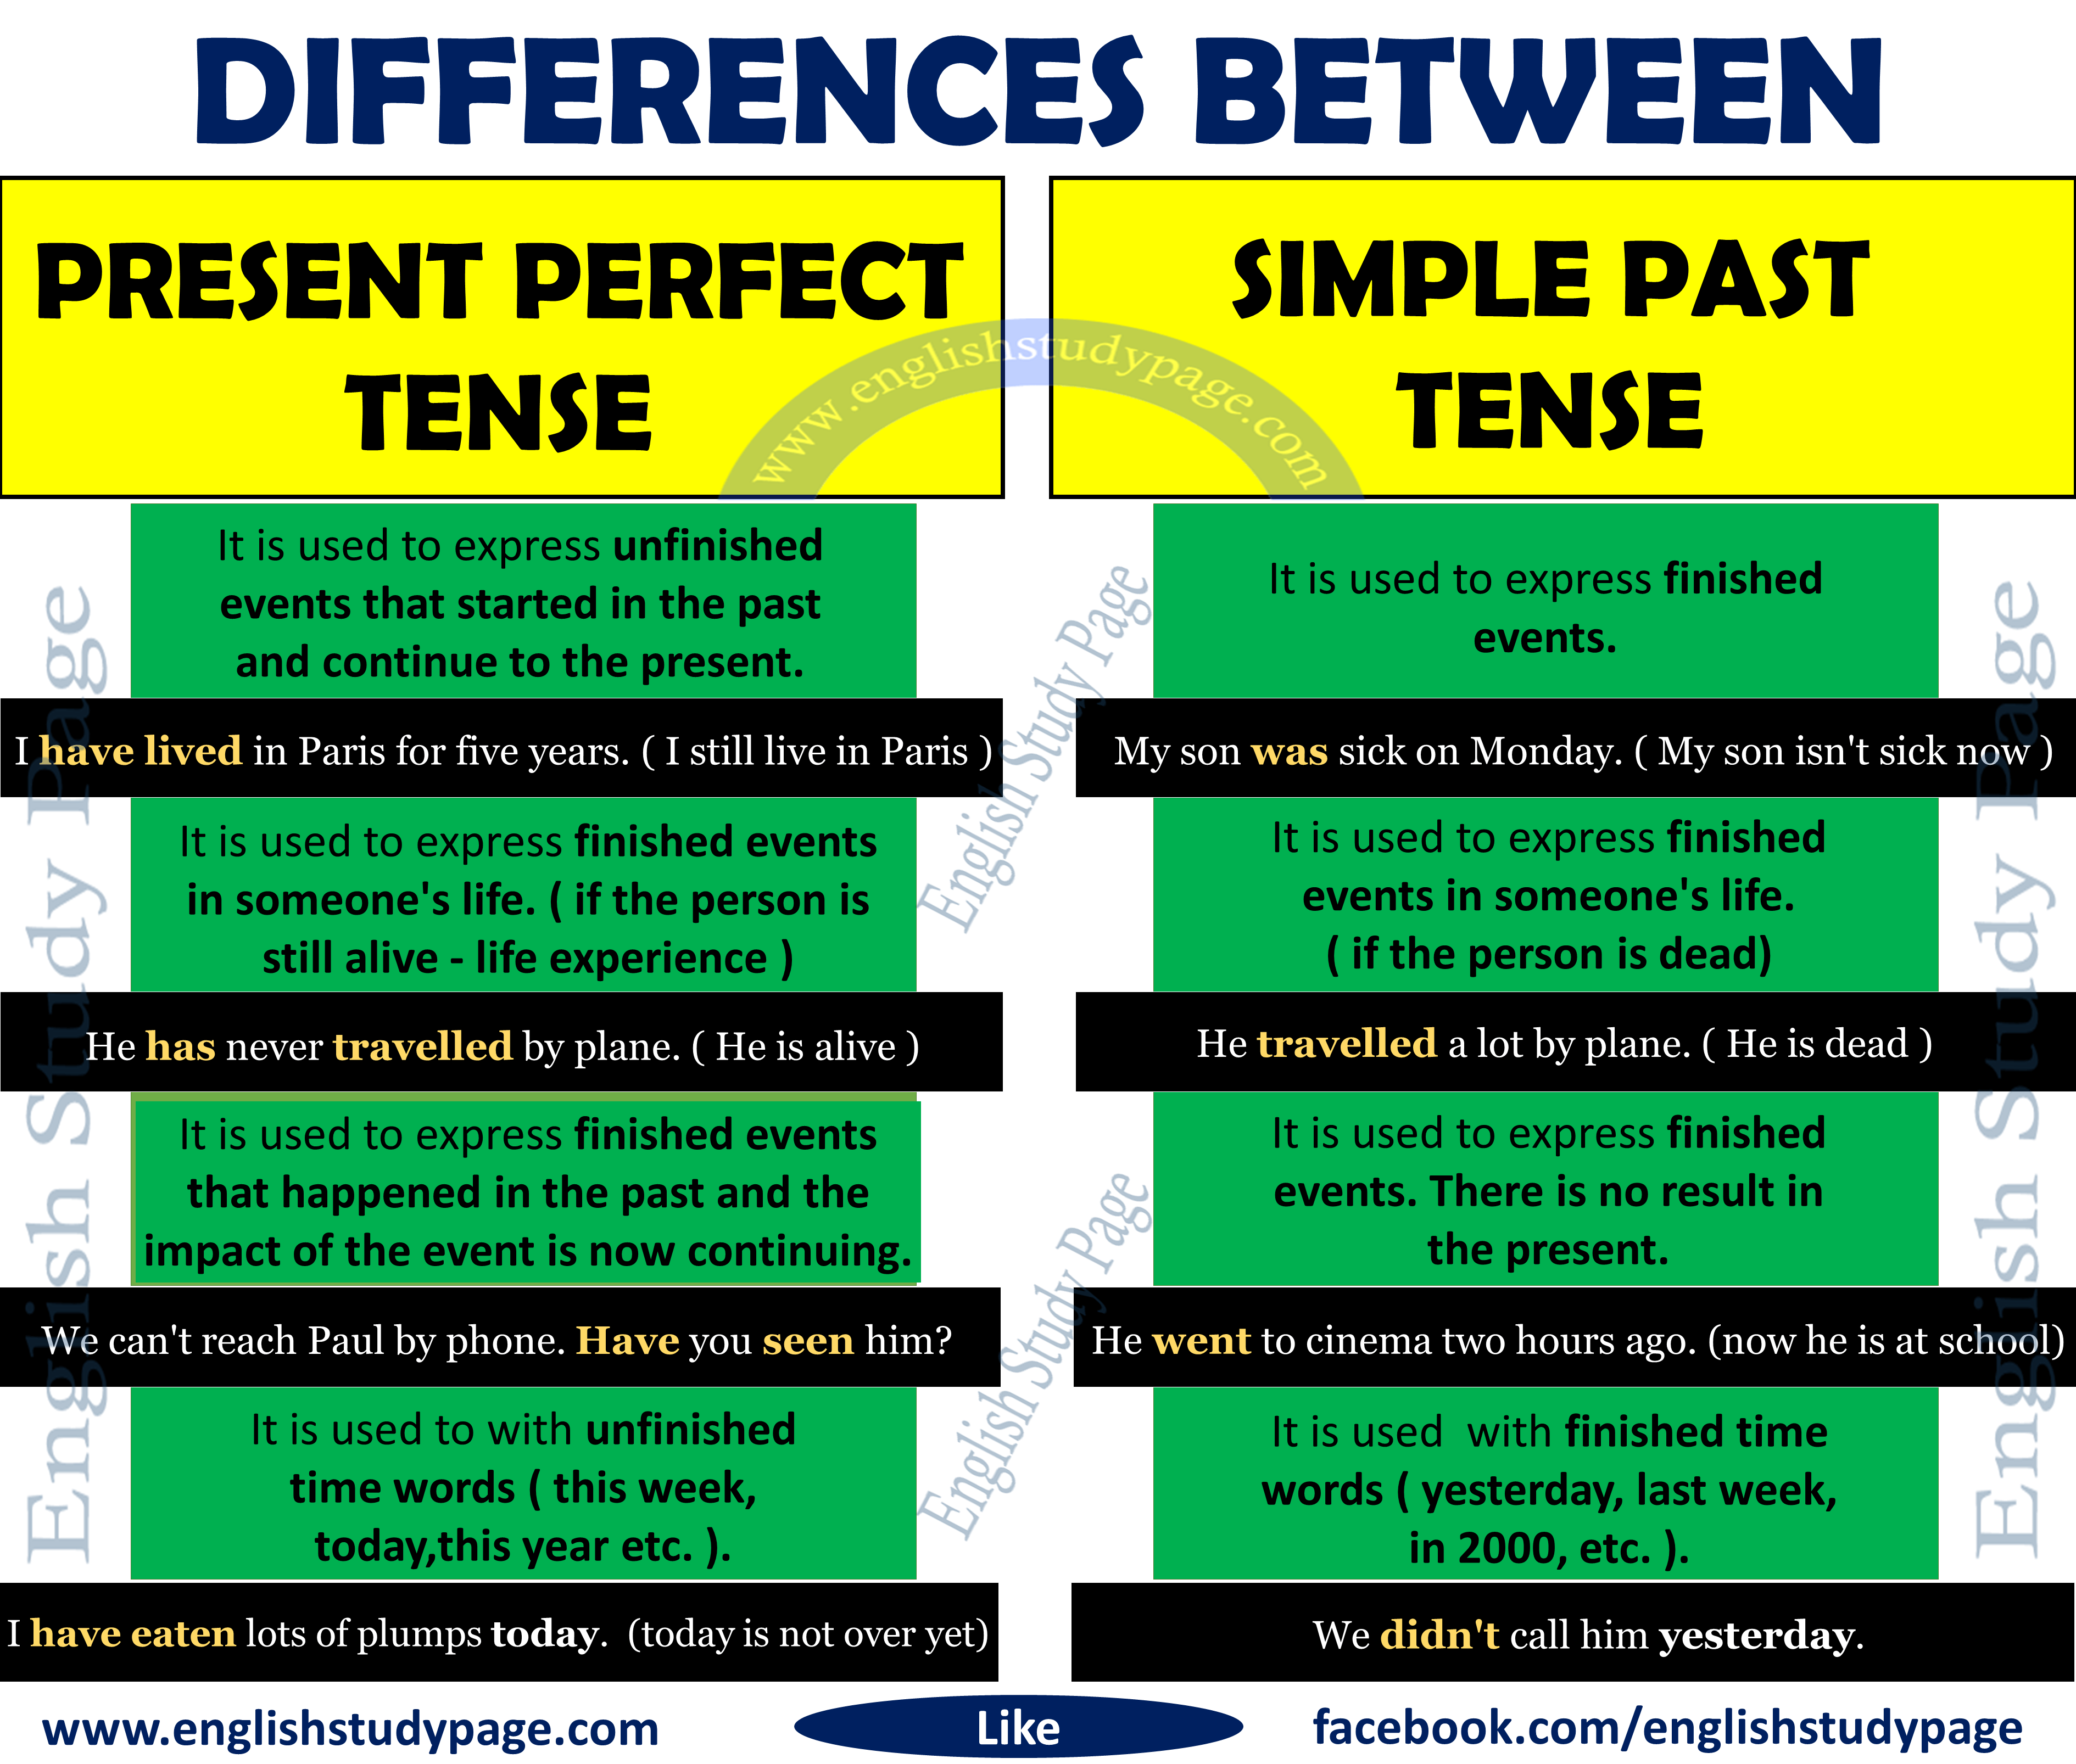

Slide 29
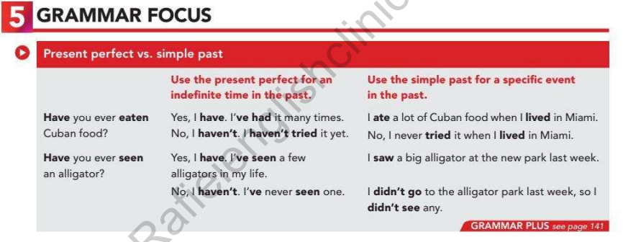

Slide 30
Use the Present perfect for an indefinite time in the past:
Have you ever seen an alligator?
Yes, I have. I’ve seen a few alligators in my life.
No, I haven’t . I’ve never seen one.

Slide 31
Use the simple past for a specific event in the past:
Have you ever seen an alligator?
I saw a big alligator at the new park last week.
I didn’t go to the alligator park last week,so I didn’t see any.

Slide 32
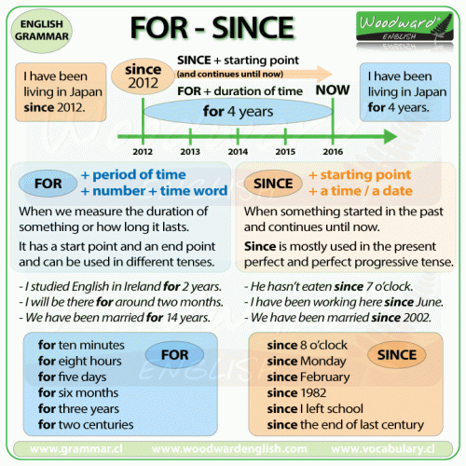

Slide 33
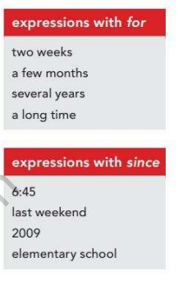

Slide 34
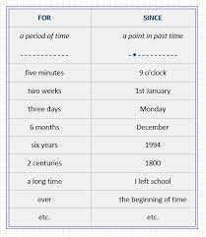

Slide 35
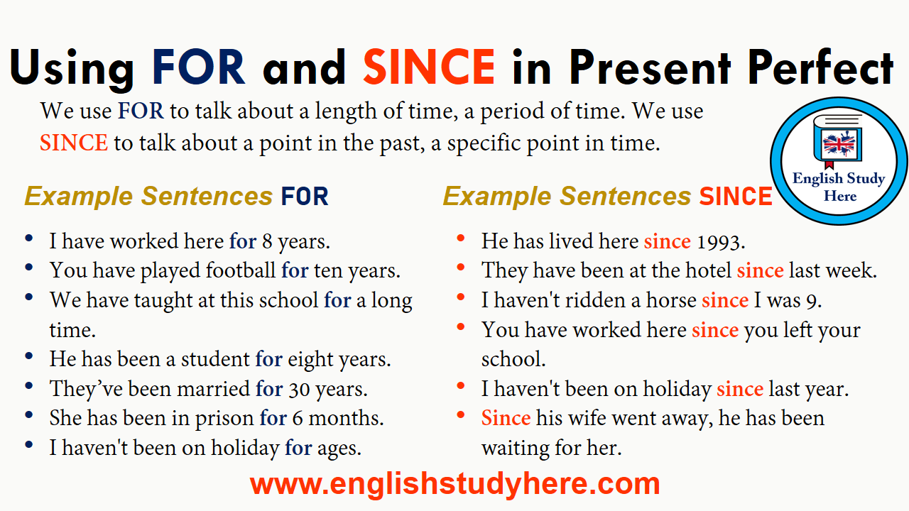

Slide 36
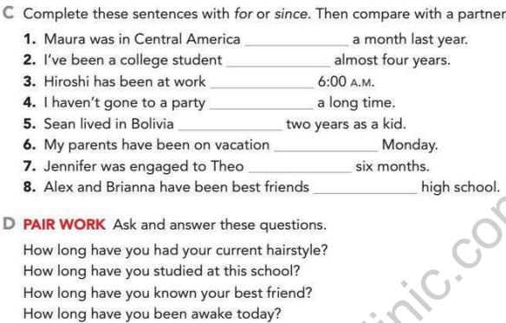

Slide 37


Slide 38
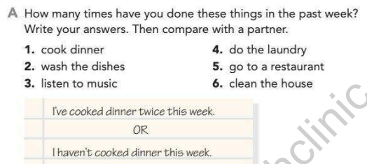

Slide 39
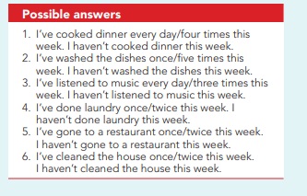

Slide 40
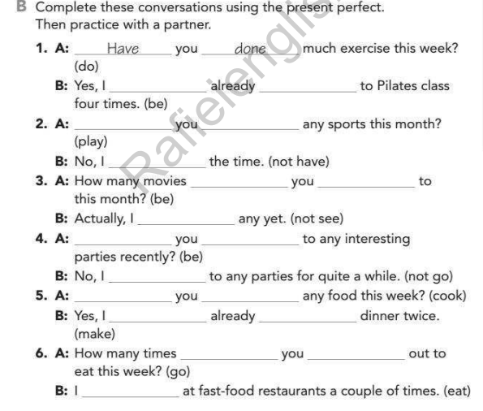

Slide 41
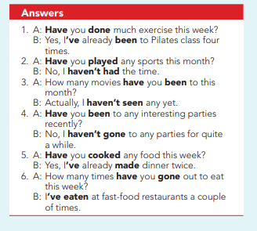

Slide 42
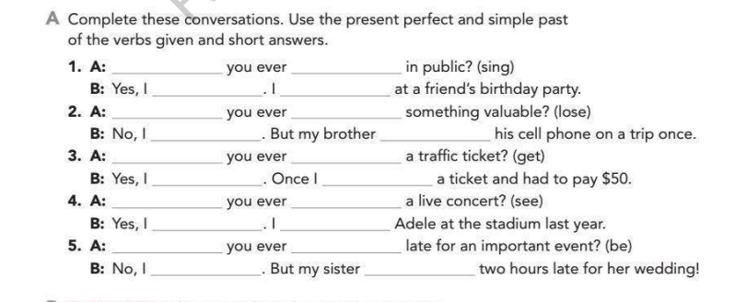

Slide 43
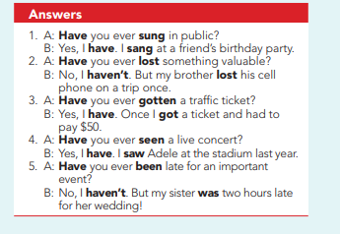

Slide 44
WORKSHEET ON SIMPLE PAST

Slide 45
I _____You _________ my window’s glass. (break)
something near that place. (see)
He _____ from London sometimes ago. (come)
She ______ an iPhone. (buy)
He ________ anyone yet for the mission. (not/choose)
____ they ______ with the committee? (speak)
He ______ on the table all day. (stand)
His head ______ to the door. (strike)
I ______ about this earlier. (hear)
The birds _____ away in the sky. (flying)
____ you _____ with her yesterday? (sleep)
Our soldiers _____ the battle. (win)
A Farmer _________ suicide after hearing this news. (commit)
He _____ a letter to the principal. (write)
An apple _______ from the tree. (fall)

Slide 46
You broke my window’s glass. (break)
I saw something near that place. (see)
He came from London some time ago. (come)
She bought an iPhone. (buy)
He did not choose anyone yet for the mission. (not/choose)
Did they speak with the committee? (speak)
He stood on the table all day. (stand)
His head struck the door. (strike)
I heard about this earlier. (hear)
The birds flew away in the sky. (flying)
Did you sleep with her yesterday? (sleep)
Our soldiers won the battle. (win)
A farmer committed suicide after hearing this news. (commit)
He wrote a letter to the principal. (write)
An apple fell from the tree. (fall)

Slide 47
WORKSHEET ON PRESENT PERFECT

Slide 48
Sam _________ his friend in the 100 m race. (beat)
The monkey ___________ on his leg in the jungle. (bite)
_____ you ______ all the documents carefully? (keep)
The dust __________ everywhere in the kitchen. (blow)
She ___________ anything yet for the party wearing. (not/ choose)
_____ we ______ this task completely? (do)
He _______ most of the time playing games. (spend)
She _________ a single word yet. (speak)
Where _____ he _______ yesterday? (sit)
I __________ all the terms and conditions of your company. (read)
She _______ already ______ the bill with an extra tip. (pay)
He ______ suddenly from the cafe. (leave)
_____ you ______ that musical voice coming from that direction? (hear)
The grass _______ very long these days. (grow)
He _________ under the pressure of his boss. (work)

Slide 49
Sam has beaten his friend in the 100 m race.
The monkey has bitten on his leg in the jungle.
have you kept all the documents carefully?
The dust has blown everywhere in the kitchen.
She hasn’t chosen anything yet for the party wearing.
have we have done this task completely?
He has spent most of the time playing games.
She has spoken a single word yet.
Where has he sat yesterday?
I have read all the terms and conditions of your company.
She has already paid the bill with an extra tip.
He has left suddenly the cafe.
have you heard that musical voice coming from that direction?
The grass has grown very long these days.
He has worked under the pressure of his boss.

Slide 50
Simple past
I _____ to the mall after school.
1 goes 2 gone 3 went
My brother _____ a bear an hour ago.
1 seen 2 saw 3 sees
3. _____ Mike visit his grandmother last night?
1 Did 2 Are 3 Does

Slide 51
4. Alex did not _____ last weekend.
1 working 2 worked 3 work
5. _____ Judy and Liz at last month's meeting?
1 Was 2 Were 3 Are
6. We _____ not happy after the sad ending.
1 were 2 was 3 did
7. _____ you see Jody's new dog yesterday?
1 Are 2 Did 3 Do

Slide 52
1. WENT
2. SAW
3. DID
4. WORK
5. WERE
6. WERE
7. DID

Slide 53
PRESENT PERFECT
Lindsay _____ not been to France.
has is have
2. _____ you finished your homework?
Have Has Is
3. They___ gone to a rock concert.
's 'es 've

Slide 54
4. _____ you been to Japan?
Is Have Has
5. We _____ never eaten Mexican food.
have has are

Slide 55
1 HAS
2 HAVE
3 ‘VE
4 HAVE
5 HAVE

Slide 56


